Slide 1
NAMMA TN SCHEMES
CS3811—PROJECT WORK
A Citizen-Centric Software Solution
MENTOR
Dr.E.Siva Sankari,
Associate Professor,
Department of CSE
GCE,Tirunelveli
TEAM MEMBERS
Esakki subha M
Meena Devi J
Vijayalakshmi M

Slide 2
Problem Statement
How might you create a user-friendly software solution to map government schemes to beneficiaries based on their socio-economic background? Ensure real-time access and a citizen-centric design for efficient grievance redressal.

Slide 3
Introduction
Government schemes are designed to uplift various sections of society including socio-economically weaker sections,farmers,students,and women.
Beneficiaries face challenges are,
i. Many lack of awareness about available schemes
ii. Complex application processes
Difficulty in determining eligibility
Our platform aims to simplify the schemes discovery process by categorizing schemes into sectors such as
1.Agriculture 4.Employment
2.Education 5.Healthcare
3.Women Empowerment

Slide 4
Objective
Develop a citizen-friendly system to map schemes efficiently.
Provide real-time access to government benefits.
Ensure transparency and simplify grievance redressal.
Enhance accessibility through a mobile-friendly and user-friendly interface
Enable personalized recommendations based on socio-economic criteria

Slide 5
Existing System
Manual application process for schemes.
Lack of real-time tracking.
Citizens struggle to find relevant schemes.
Limited grievance resolution mechanisms.
Overloaded with schemes – No clear categorization based on user needs (Farmers,Women, Students, etc.).

Slide 6
Proposed System
Web-Based Platform for Tamil Nadu Schemes
A user-friendly online portal providing easy access to all Tamil Nadu government schemes.
Easy Navigation & Search Filters
Simplified scheme discovery with category-based filters and keyword search.
Real-Time Updates & Tracking
Applicants receive instant notifications on application status, ensuring transparency.
Mobile-Friendly Design
Accessible across smartphones, tablets, and desktops for wider reach.

Slide 7
Implementation
User Registration & Authentication - Mobile/E-mail verification
User Profile Management - Income level, Occupation,Age
Government Scheme Mapping - Education, Health, Employment, Agriculture
Real-Time Eligibility Checking - List of eligible schemes with direct apply option
Grievances Redressal Systems-Allow users to submit complaints regarding scheme access or processing delays.
Application & Tracking - Application status tracking (Pending, Approved, Rejected)

Slide 8
Methodology 1.Data Collection:
Education | Health | Employement | Agriculture | Women Empowerment
Naan Mudhalvan Scheme | Girl child protection scheme | Differently abled pension scheme | Distribution of value addition scheme | Amma two wheeler scheme
Free Education Scheme | Transgender pension scheme | Tamilnadu unemployment assistant scheme | Chief minister’s scheme of solar powered scheme | Dr.Muthulakshmi reddy maternity benefit scheme
Post matric schlorship | Marriage Assistance scheme for women | TIIC Government subsidy loan for business | Seed production scheme | Rural institute of development scheme
Tamil pudhalvan scheme | Assistance to Differently abled persons | Unemployment youth Employment Generation programme | Kudimaramath scheme | Thalikku thangam thittam
Data Collection:

Slide 9
CATEGORIES | SCHEME NAME | ELIGIBILITY
Education | Naan Mudhalvan | i)Age:18 and above ii)TN Residents only iii)Students prepare for competitive exam like SSC,IBPS AND Railways
Health | Girl child protection scheme | i)One or two girl children ii)Family income below ₹72000
Agricultural | National Agriculture Development programme | i)All farmers are eligible ii)Small,Marginal,SC/ST women
Employment | Tamilnadu Unemployment Assistant Scheme | i)TN Residents only ii)Income below ₹72000 iii)Age limit:40 years
Women Empowerment | Amma two wheeler scheme | i)Working women only ii)50% of subsidy with ₹25000
SCHEME NAME | ELIGIBILITY

Slide 10
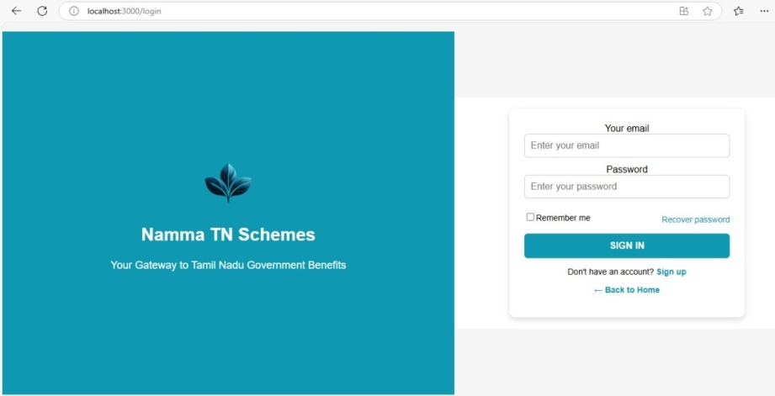
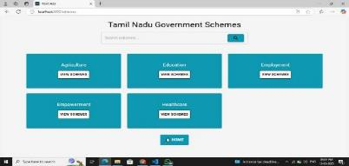
2.System Design:
Designing a user-friendly interface for scheme discovery
and
Sign up &Login page
Scheme Categorization Page

Slide 11
1. Scheme Details Page
Displays details of selected schemes.
Shows eligibility criteria and benefits.
Provides an "Apply Now" button, if the user is eligible.
2. Application Form Page
Collects user information required for application.
Allows users to submit applications for selected schemes.
3. Grievance Redressal Page
Users can submit complaints or queries about their applications.
Status updates on grievance resolution.

Slide 12
Database-Name:
Tn_schemes
1.User Data Collection

Slide 13
4. Technology Selection
Frontend: React.js for a dynamic and responsive UI.
Backend: Node.js for handling requests and data processing.
Database: MongoDB for storing scheme details and user application
5. Testing
Perform unit and integration testing to ensure smooth functionality.
Conduct user testing to verify ease of access and usability.
6. Deployment & Maintenance
Deploy the system on a secure web server.
Provide updates based on user feedback and government policy changes.

Slide 14
THANK YOU

